Slide 1

Careers and Work Related Learning
Year 10
Unlock Your Potential

Slide 2
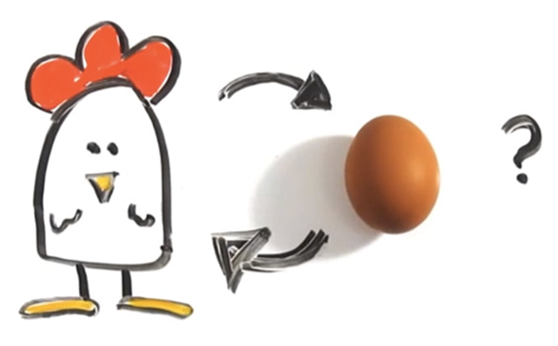
Why do work experience?
To crack the “Chicken & Egg” problem – can’t get a job with out experience – can’t get experience without a job.
Statutory Requirement

Slide 3
Why Year 10?
Learn what they like or perhaps they don’t like!
The expectation is that they will have had work experience before they apply for certain university courses – Vet, Doctor, Engineer, Teacher
Source of examples for their CV / Interview questions – ‘Tell me about a time when…..’

Slide 4

When?
At the end of Year 10
29th June -3rd July 2026
Attendance is compulsory either at placement or at school (work experience is better!)

Slide 5
Work Experience: Golden Rule
All work experience is GOOD work experience

Slide 6
Where?
The more relevant to their future career the better.
Think of related careers with similar skills e.g. the police are unlikely to offer work experience so think of jobs that use the same skill set.
They don’t need to stay in Gloucestershire.
Encourage them to Be brave…. If you don’t ask….

Slide 7
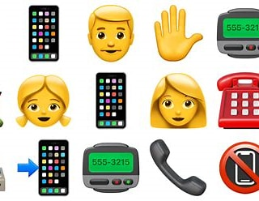
Process
Step 1: Students need to identify a work placement and make contact
Face to Face
Phone Call
Email
Letter

Slide 8
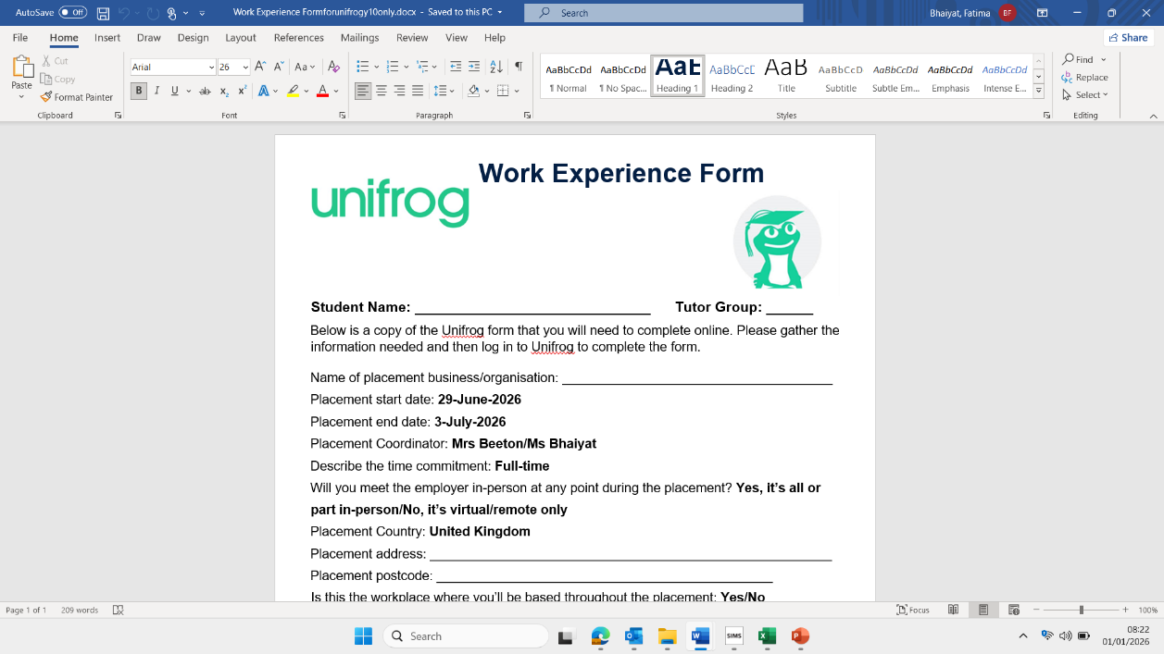
Process
Step 2: Students need to complete the Unifrog form found in their booklet and also on the school website(emailed to all Y10 students and parents).

Slide 9
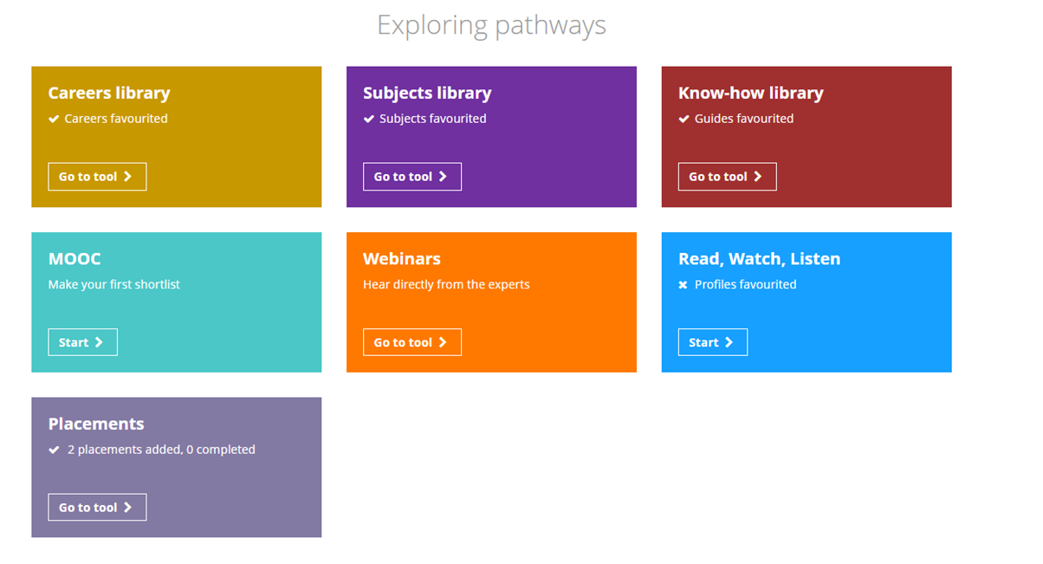

Process
Step 3: Students MUST log it on Unifrog

Slide 10

What is Unifrog?

Slide 11
Important information
Unifrog’s Placements tool is a work experience admin management tool. It helps with getting all the necessary information and agreements for work experience to take place.
The tool also includes a searchable database of placement contacts, to help schools and colleges source placements for students.
Students should only log a placement in the Placements tool after they have agreed a placement with an employer.

Slide 12

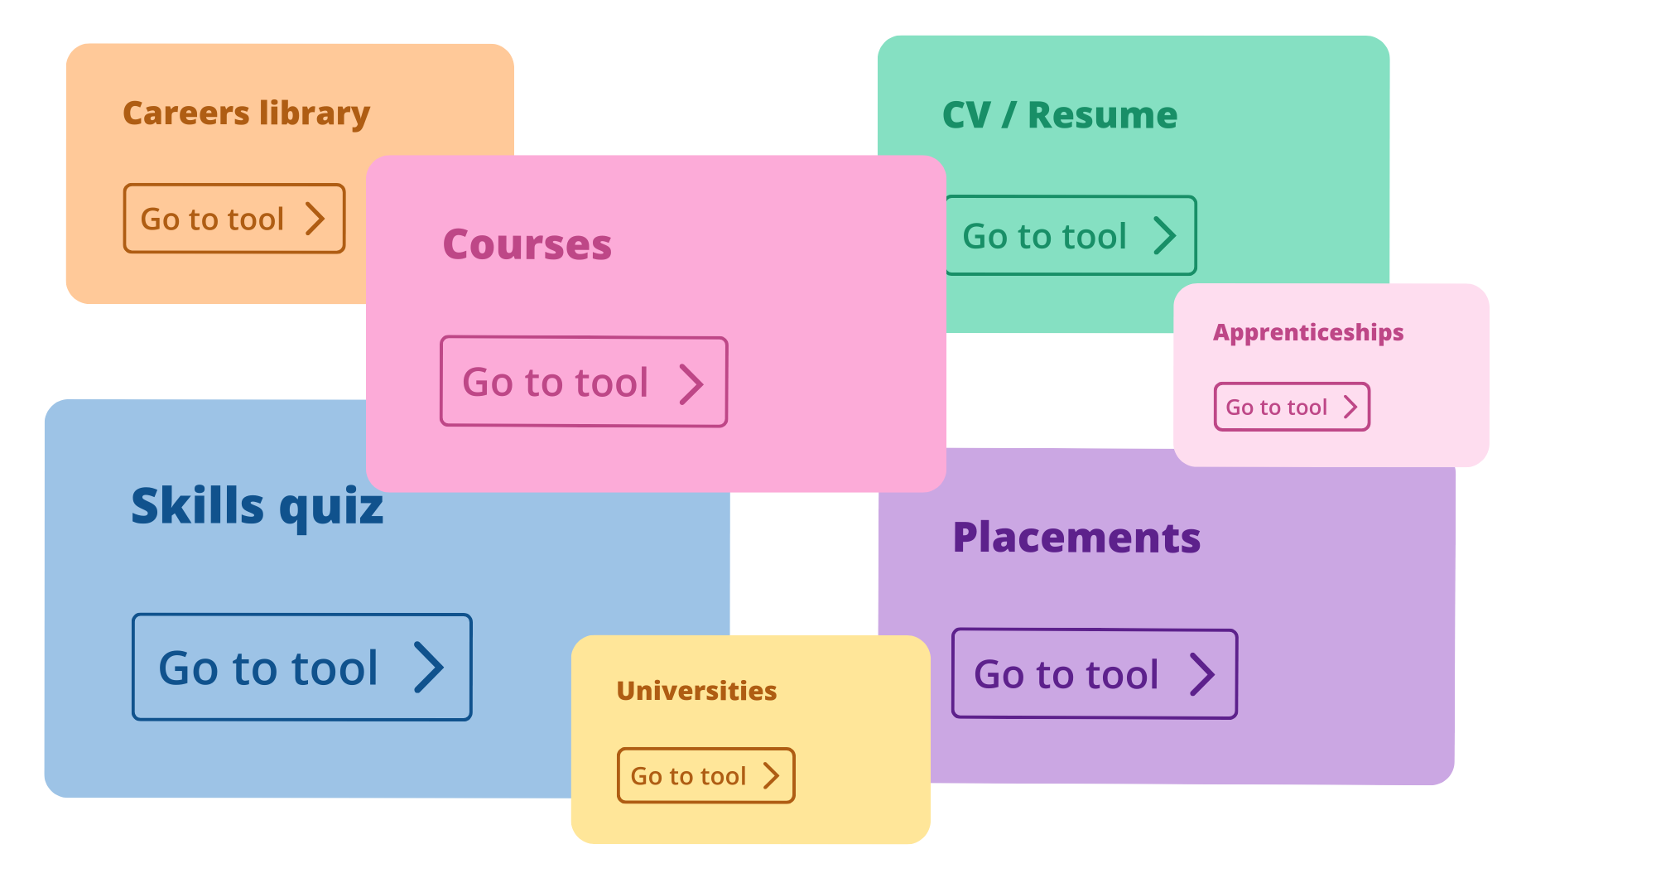
What is Unifrog?
Unifrog is an online careers platform used by over half of the secondary schools and colleges in the UK. The platform has various tools to help students research careers and future pathways,
draft CVs and personal statements,
and manage work experience.
2 min overview of Unifrog as a whole

Slide 13

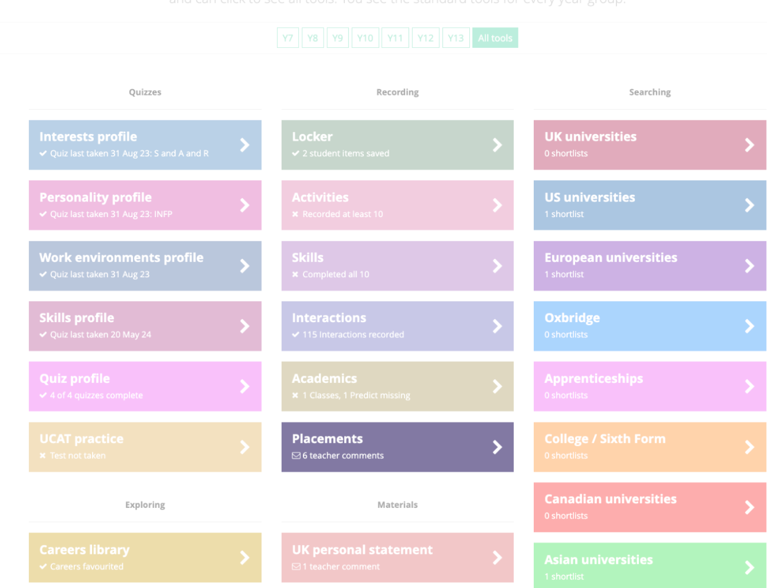
Using the Unifrog Placements tool
After the student has agreed a placement with an employer,
they need to log into their Unifrog account to log the Placement.
This starts off a chain of forms.
After the student completes the first form:
The system emails the employer to complete their form
The parent/guardian form comes next
The school/college completes their permission form
Here’s what parents/guardians need to know about placements forms.

Slide 14

Next steps
Students
Agree a placement with an employer.
Log the information on the Unifrog placements tool.
Parents/caregivers
Support your child to source a placement. Encourage them to log it on Unifrog.
Look out for an email from Unifrog once the student and the employer have
completed their forms.

Slide 15

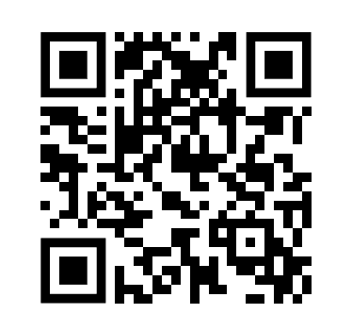


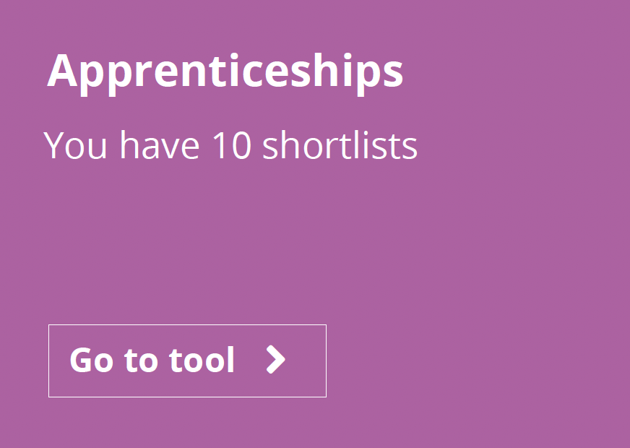
More info
Unifrog have created a set of guides about placements here.
This is the best guide to start with
(it includes a short animation of how the whole process works).
Next, we recommend looking at this guide
(it’s all about how to help your child to find a placement).
Scan the QR to
see all guides
Pro tip: check out the apprenticeships tool on Unifrog to research local employers who may be open to hosting a placement.

Slide 16

Better career decision‑making
Experiencing different workplaces and roles helps students discover what they enjoy and what they don’t. This leads to more informed choices about subjects, pathways, and future careers.
Students should also think about the skills they are developing: Communication, Teamwork, Problem Solving, Time Management, Digital Literacy.
These skills are consistently linked to higher employability and better long‑term outcomes.
Stronger connections with employers - Modern work experience emphasises real interaction with professionals rather than passive observation. This builds networks, boosts confidence, and gives students insight into workplace culture.
A more realistic understanding of the workplace -The modern approach to work experience ensures young people engage in meaningful activities that reflect real work, giving them a clearer sense of what a job or sector is actually like.
https://careers.sphs.uk.com

Slide 17
Important Dates
All forms to log in to Unifrog 12th & 13th January 2026
All forms to begin to complete booklets week commencing 2nd February
All placements to be added to Unifrog Friday 20th March
All placements to be approved by parents 3rd April
Work experience dates 29th June -3rd July 2026
School website, School Information, Work Experience Y10

Slide 18
Thank you for listening

