Slide 1
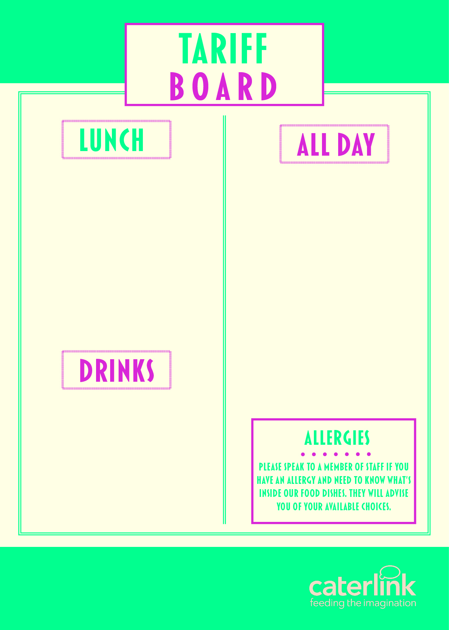

MAIN MEAL (FSM) – HOT | £2.65
MAIN MEAL (FSM) – COLD | £2.65
HOT DESSERT | £1.20
MAIN MEAL | £2.40
JACKET POTATO & 1 FILLING | £2.20
PASTA & SAUCE | £2.25
PASTA, SAUCE & CHEESE | £2.90
PANINI (JUST CHEESE) | £2.25
PANINI (2 FILLINGS) | £2.45
HOMEBAKE | £1.20
PIZZA SLICE FROM | £1.75
SANDWICHES FROM | £1.70
BAGUETTES FROM | £2.00
WRAPS FROM | £2.00
FRUIT POTS | £1.25
SAUSAGE ROLLS | £1.65
HOT FILLED ROLLS FROM | £1.85
HASH BROWNS | £0.60
BURGERS FROM | £2.25
TOAST CHEESE ON TOAST FRESH FRUIT | £0.30 £0.95 £0.75
COOKIE | £1.30
PAIN AU CHOCOLATE | £1.50
CROISSANT | £1.50
WAFFLE | £1.65
DESSERT POTS | £1.35

